Slide 1

ADVENTURE WORKS
A comprehensive data analytics journey exploring sales trends, profitability patterns, and strategic insights from a global bicycle manufacturer.
Group Members :
Ganesh Dudhal
Manasi Daph
Bhavani Kulkarni
Chetan Dinesh

Slide 2
Index
Data Analytics Pipeline & Methodology
Financial Performance Overview
Excel Dashboard
SQL Queries
Power Bi Dashboard
Tableau Dashboard
Key Findings & Strategic Recommendations
Challenges Faced & How Challenges Were Overcome
Conclusion

Slide 3
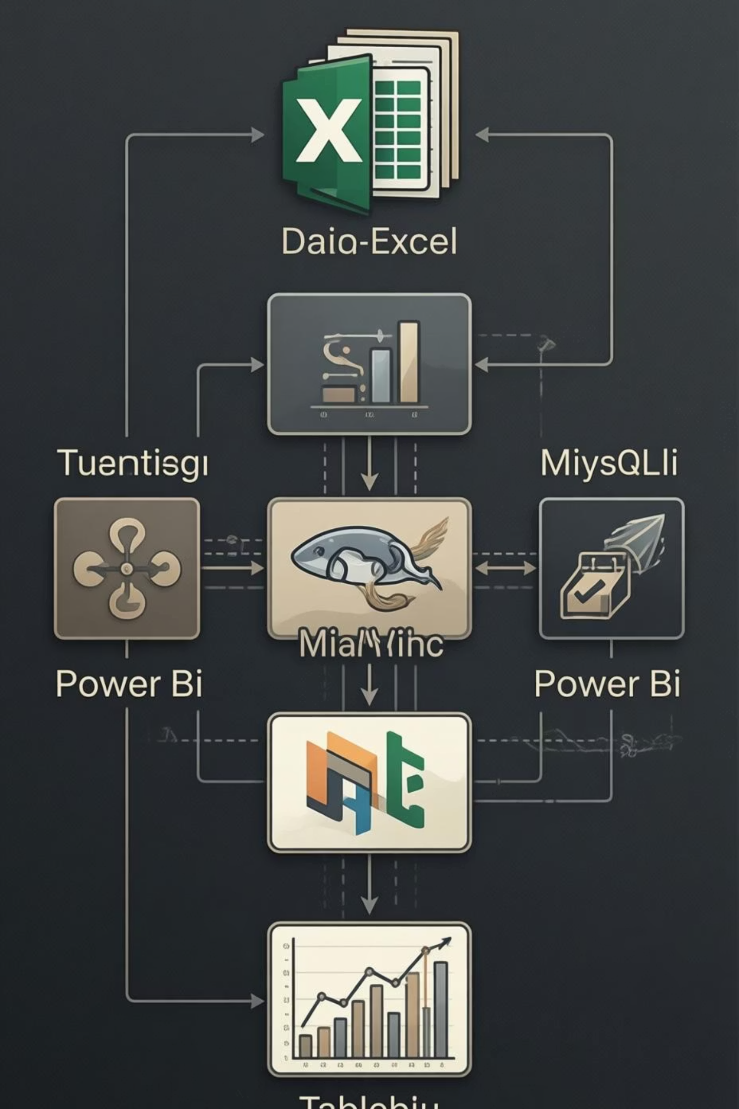
DATA ANALYTICS PIPELINE & METHODOLOGY
01
DATA COLLECTION & PREPARATION
Gathered multi-year transactional data covering orders, customers, products, and sales territories
across global markets
02
EXCEL MODELLING & DASHBOARDS
Created pivot tables, calculated fields, and interactive dashboards for month/year/quarter analysis and country/product performance tracking
03
MYSQL DATABASE DEVELOPMENT
Designed and populated relational database with fact and dimension tables, performed date transformations and business metric calculations
04
ADVANCED VISUALISATION
Developed comprehensive dashboards in Power BI and Tableau for stakeholder reporting and strategic
decision-making

Slide 4
FINANCIAL PERFORMANCE OVERVIEW
Analysis period: 2010-2014 (primary focus on 2011-2013 peak performance years)
$29.36M
$12.08M
41%
60,398
TOTAL SALES REVENUE
TOTAL PROFIT
PROFIT MARGIN
TOTAL ORDERS
Cumulative sales across all markets and product categories
Strong profitability demonstrating effective cost management
Exceptionally healthy margin for manufacturing industry
Unique transactions processed across all channels

Slide 5
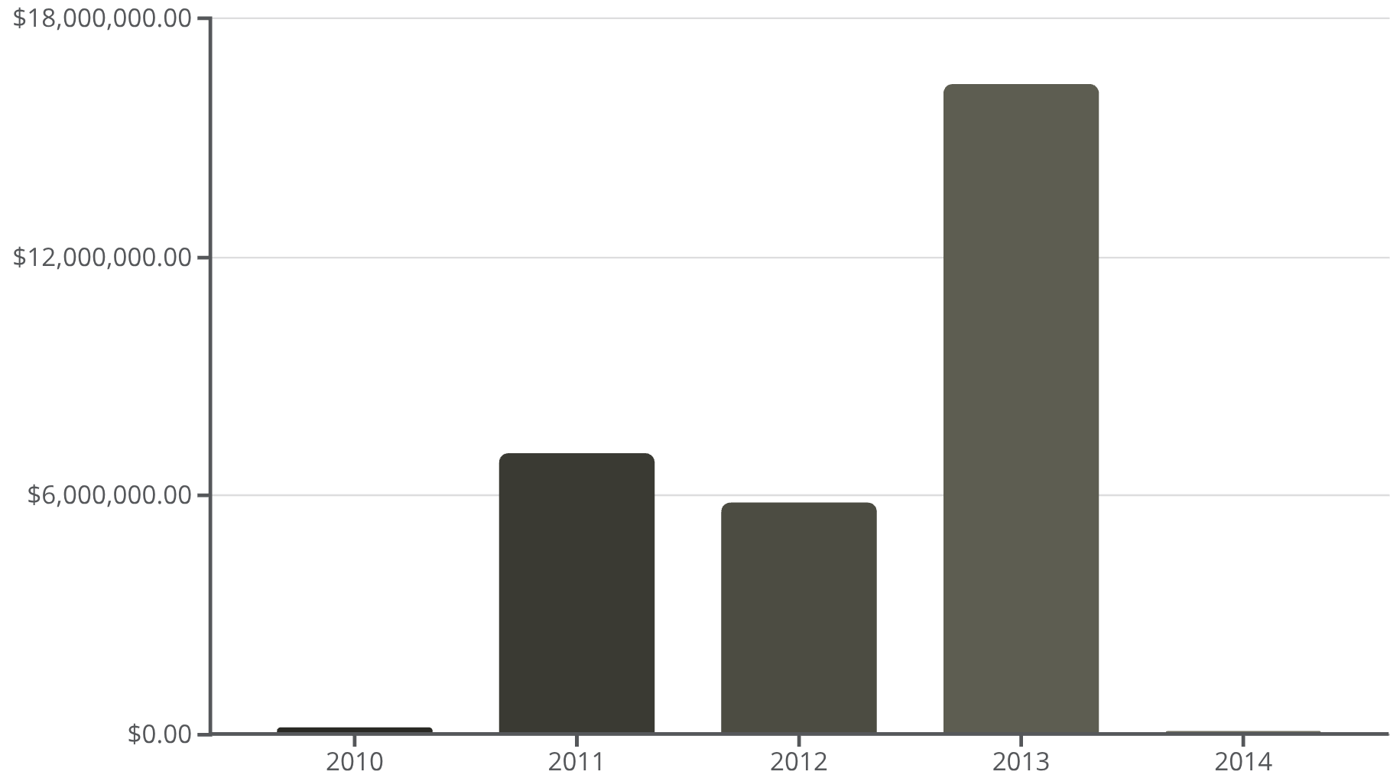
YEAR-ON-YEAR SALES TRENDS
2013: THE GOLDEN YEAR
2013 represented a watershed moment, accounting for over 55% of total sales across the analysis period. This exceptional performance suggests successful product launches, effective marketing campaigns, or favourable market conditions.
The dramatic spike warrants deeper investigation into specific strategies, customer segments, and competitive positioning that drove this remarkable growth.

Slide 6




SEASONAL SALES PATTERNS & QUARTERLY PERFORMANCE
31%
26%
Q4 PERFORMANCE
Q3 PERFORMANCE
Highest quarterly sales at $9.11M driven by year-end holidays
Strong summer cycling season with $7.64M in sales
24%
19%
Q2 PERFORMANCE
Q1 PERFORMANCE
Spring momentum building with $7.09M revenue
Slowest quarter at $5.52M reflecting winter seasonality
Clear seasonality visible with peaks during Q4 holiday season (November-December) and summer cycling months (June-August). February and January consistently show weakest performance.

Slide 7
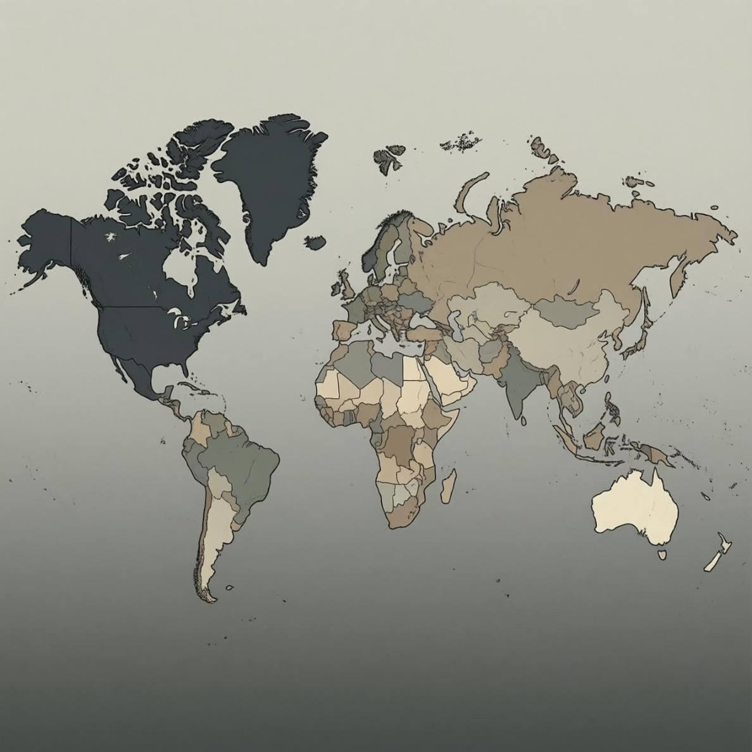
MARKET DISTRIBUTION & GEOGRAPHIC OPPORTUNITIES
CURRENT MARKET PRESENCE
United States — Dominant market with strongest sales contribution
Canada — Established presence with growth potential
Europe — Emerging markets in France, UK, and Germany
Pacific — Initial foothold in Australia
Strategic Insight: Significant opportunity exists to expand aggressively in under-penetrated European and Asia-Pacific markets where cycling culture is strong but Adventure Works presence remains limited.

Slide 8
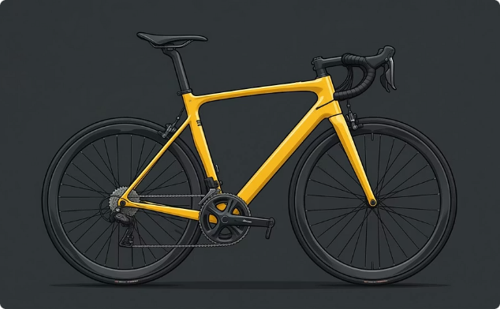


TOP-PERFORMING PRODUCTS & CATEGORIES
ROAD BICYCLES
CYCLING APPAREL
ACCESSORIES
Road-350-W Black, 48 and similar models drive majority of revenue with strong margins and customer loyalty
Short-Sleeve Classic Jerseys across sizes generate consistent volume with healthy profit margins
Half-Finger Gloves, Racing Socks, Water Bottles, and Patch Kits provide strong complementary revenue streams

Slide 9
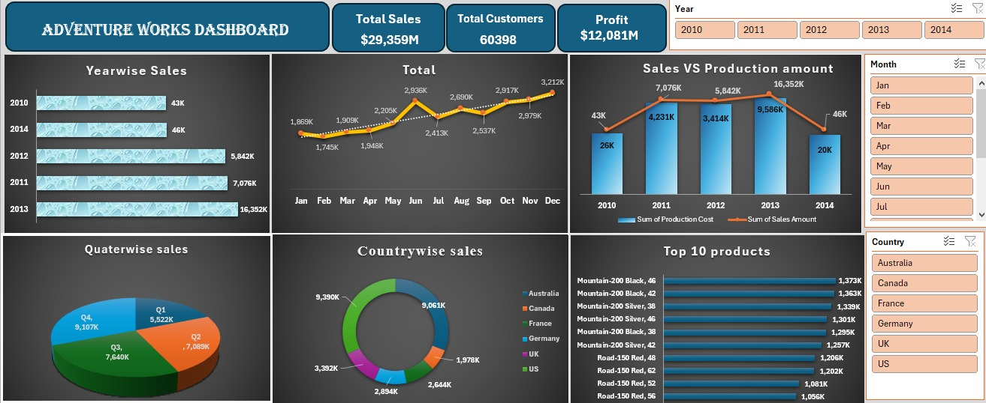
Excel Dashboard

Slide 10
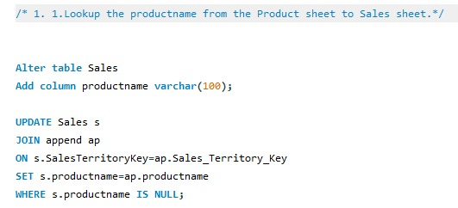
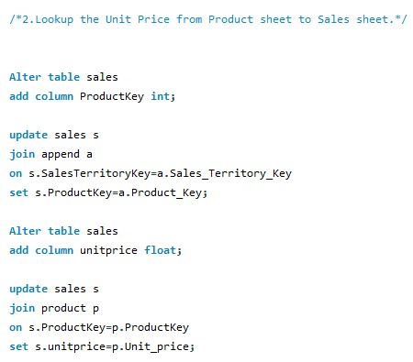
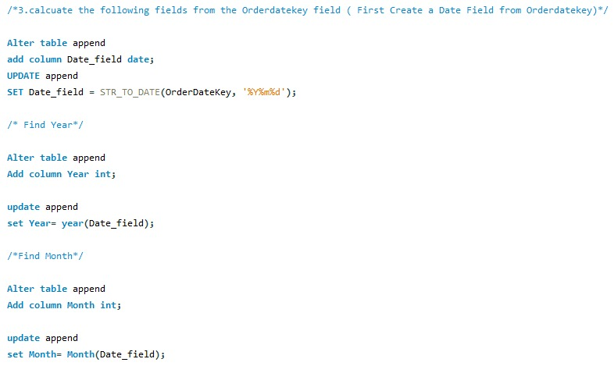
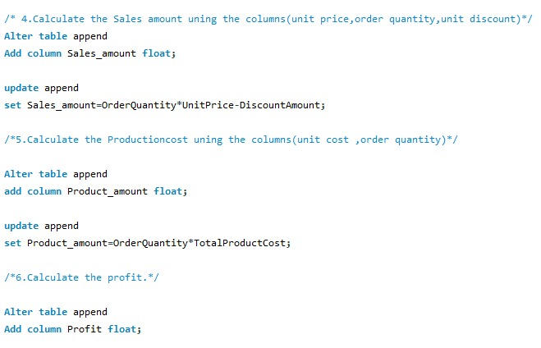
SQl Queries

Slide 11
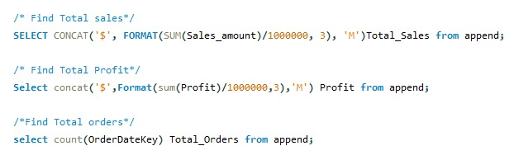
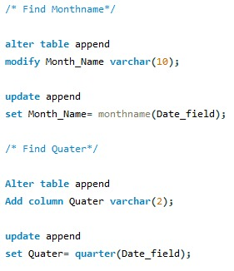
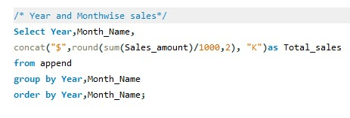
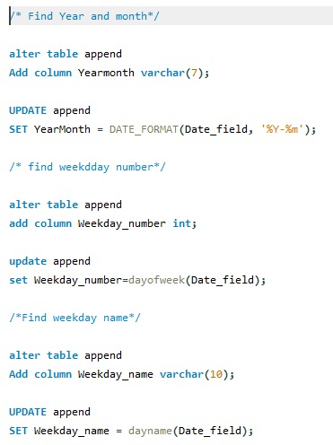
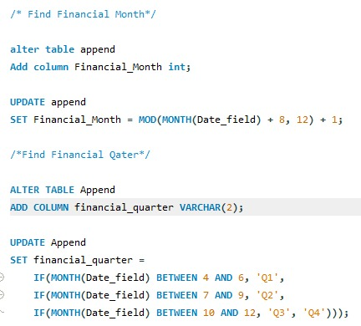
SQl Queries

Slide 12
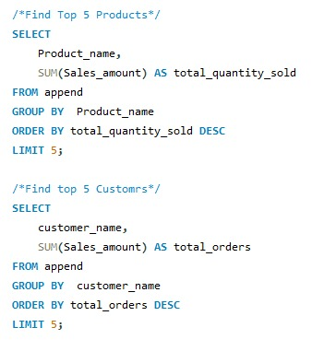
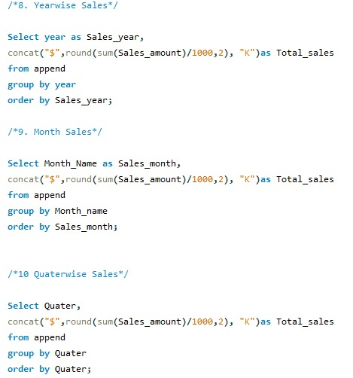
SQl Queries

Slide 13
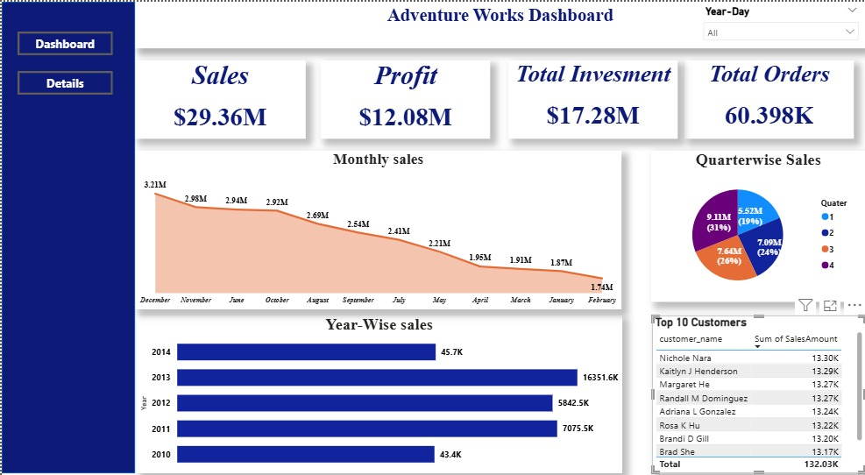
Power bi Dashboard

Slide 14
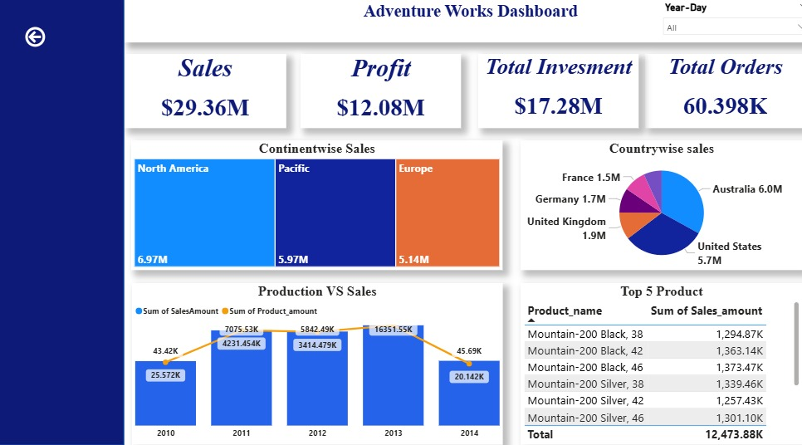
Power bi Dashboard

Slide 15
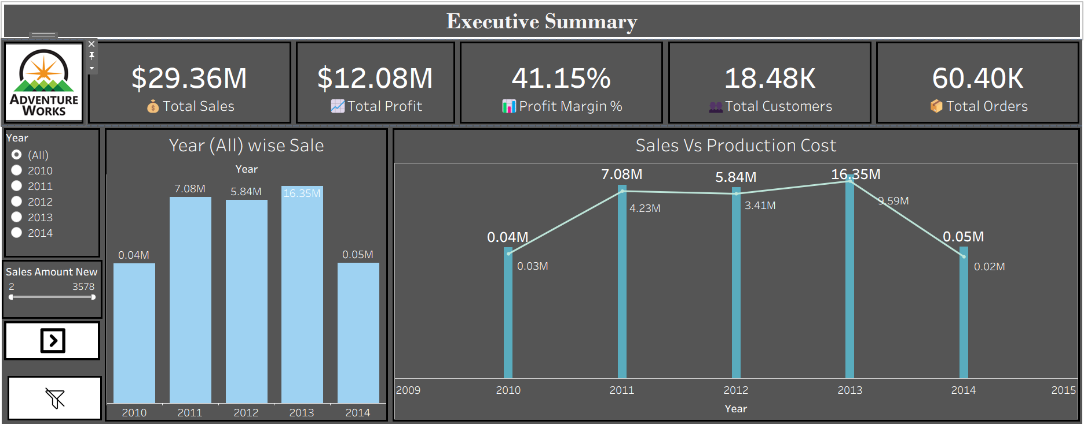
Tableau dashboard

Slide 16
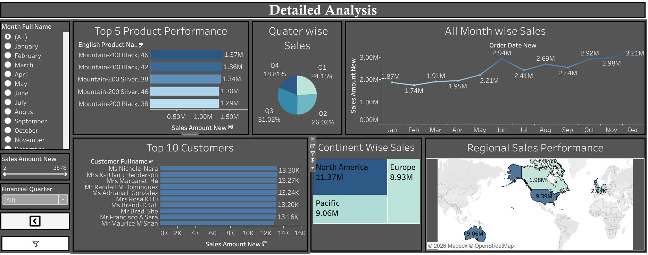
Tableau dashboard

Slide 17
KEY FINDINGS & STRATEGIC RECOMMENDATIONS
2013 SUCCESS ANALYSIS REQUIRED
LEVERAGE SEASONAL INTELLIGENCE
MAINTAIN COST EXCELLENCE
Conduct detailed investigation into strategies, products, and market conditions that drove the exceptional 2013 performance to replicate success in future years
Optimise inventory management, promotional campaigns, and staffing allocation around Q4 peak and summer cycling season to maximise returns
With 41% profit margin demonstrating excellent production cost control, continue process optimisation and supplier negotiations whilst protecting quality standards
ACCELERATE GEOGRAPHIC EXPANSION
PRODUCT PORTFOLIO OPTIMISATION
Prioritise investment in European and Pacific markets where cycling infrastructure and culture support growth but Adventure Works presence remains minimal
Continue focus on high-margin road and mountain bikes whilst expanding accessory offerings that generate consistent volume with strong customer attachment rates

Slide 18




CHALLENGES FACED
Raw data with date keys instead of actual dates.
Data spread across multiple tables and CSV files.
Missing calculated metrics like profit and production cost.
Limited or partial data for some years.
HOW CHALLENGES WERE OVERCOME
Converted date keys into proper date, month, quarter,
and financial periods using SQL.
Joined fact and dimension tables to retrieve product
and customer details.
Calculated sales, cost, and profit using SQL and validated
results in Excel.
Built structured dashboards using Excel pivot tables and
KPIs.

Slide 19

CONCLUSION
This comprehensive analysis has transformed raw data into actionable intelligence, providing Adventure Works Cycles with a clear roadmap for optimising sales, enhancing profitability, and driving sustainable growth.
By leveraging these insights, we are poised to strengthen our market position, innovate our product offerings, and build lasting customer relationships.
FUTURE READY

